Slide 1
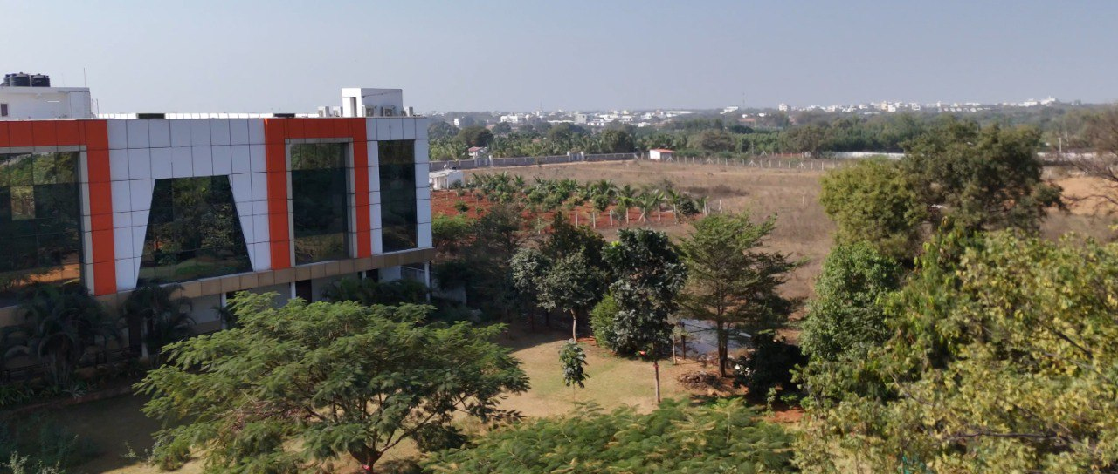



AI Driven Autonomous Navigation using
Object Detection on KLH Campus Dataset
Team Members
2210040002 – YADNYA VIDHATE
2210040019 – S ABHINAV REDDY
2210040047 – K R LOKESH KUMAR
under the guidance of
DR .K . SAI KUMAR

Slide 2
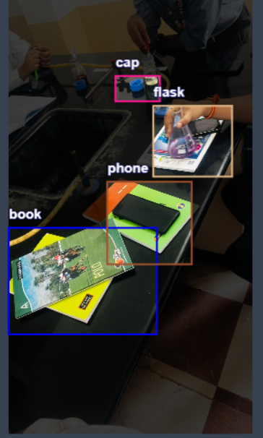
AI Driven Autonomous Navigation using
Object Detection on KLH Campus Dataset
Autonomous navigation using object detection and AI enables vehicles or robots to move independently by recognizing and avoiding obstacles in real time. This technology combines computer vision, and sensor fusion to process environmental data, ensuring safe and efficient movement without human intervention.

Slide 3
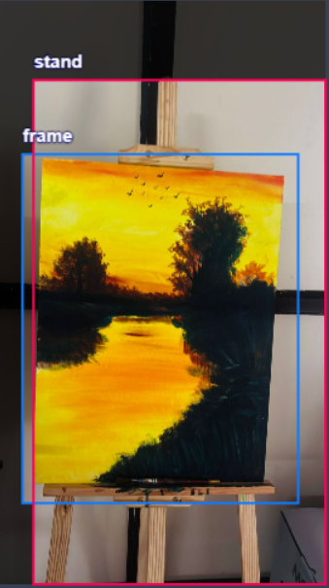
Object Detection with YOLOv8
This presentation explores the capabilities of YOLOv8, a cutting-edge object detection model, and how it can be used to solve real-world problems.

Slide 4
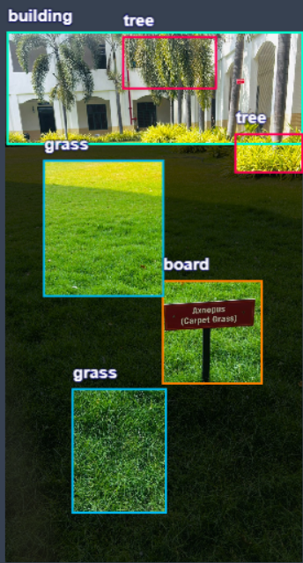

YOLOv8:
1
Enhanced Accuracy
YOLOv8 surpasses previous models in accuracy, achieving state-of-the-art performance on benchmark datasets.
2
Improved Speed
YOLOv8 maintains its real-time processing speed, making it suitable for various applications requiring fast inference.
3
Flexible Architecture
YOLOv8 offers different model sizes, allowing for customization based on performance and resource constraints.
4
Simplified Training
The training process in YOLOv8 is simplified, making it easier for developers to implement and optimize the model.

Slide 5
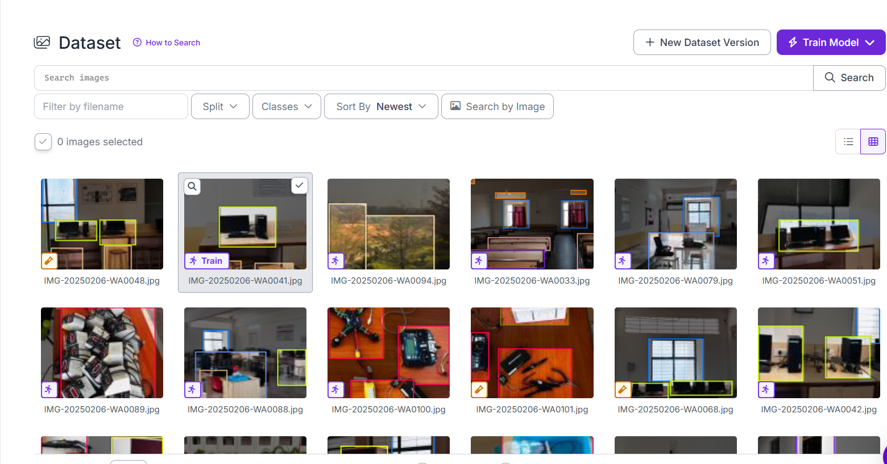
The data is collected from the college premises manually by capturing the photos of the college premises and the second stage involves labelling the photos by creating classes and epochs by using the software named roboflow which is used for labelling and training the dataset. The number of images collected is 1000

Slide 6
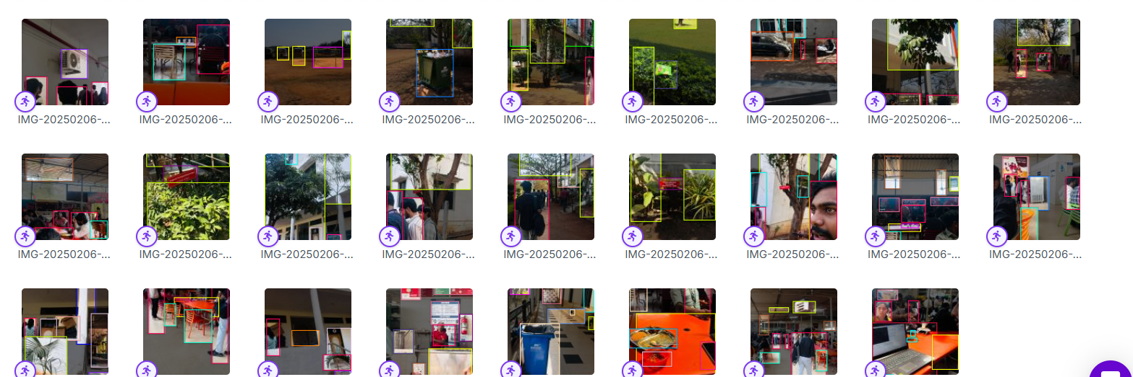

Dataset Preparation
Prepare the dataset in a format compatible with YOLOv8.
Augment the dataset with transformations like flipping, scaling, and cropping.
Split the dataset into training and test sets.
Gather images and label bounding boxes for objects of interest using Roboflow.

Slide 7
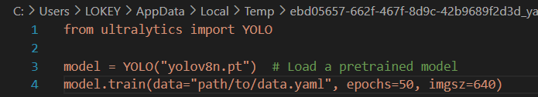
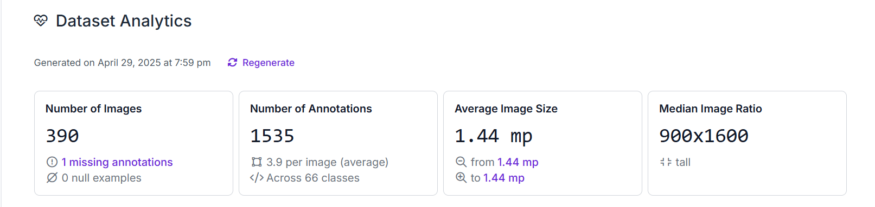
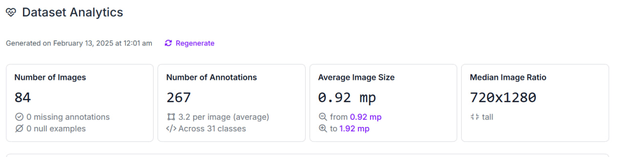

CODE TO TRAIN THE MODEL:

Slide 8
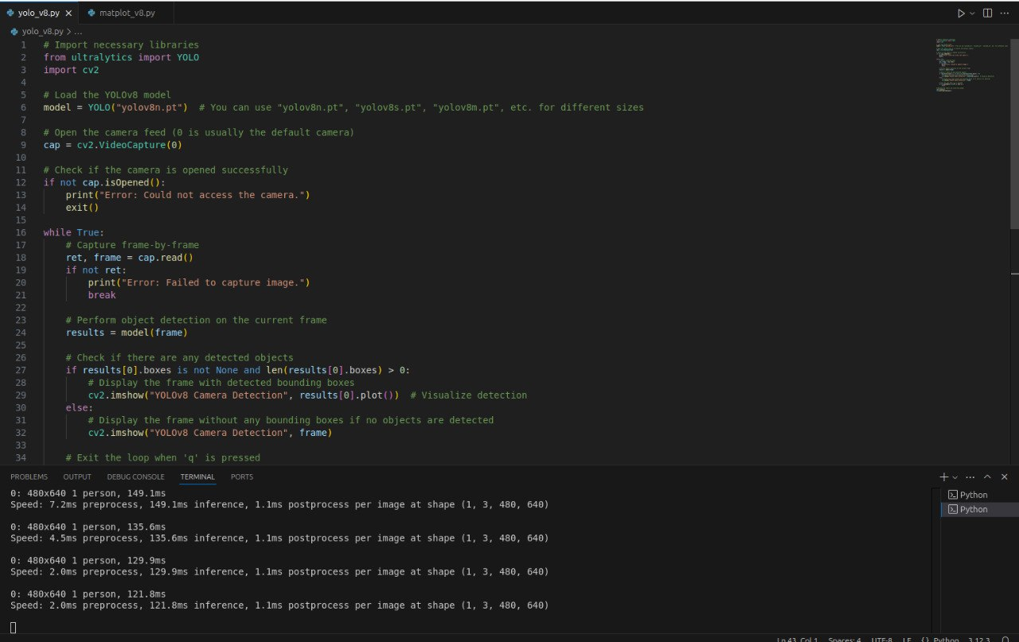
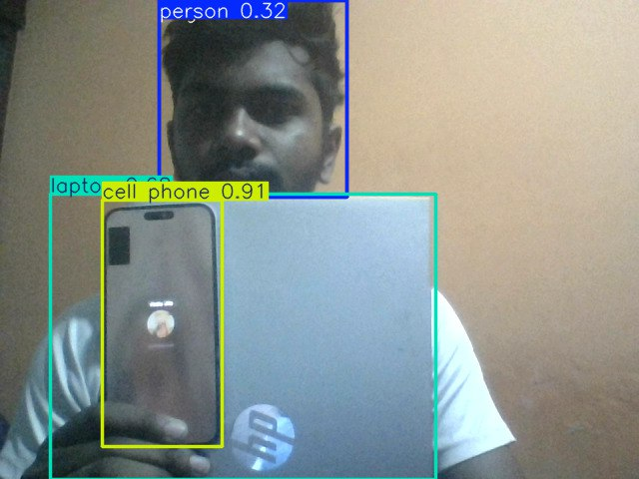

Slide 9
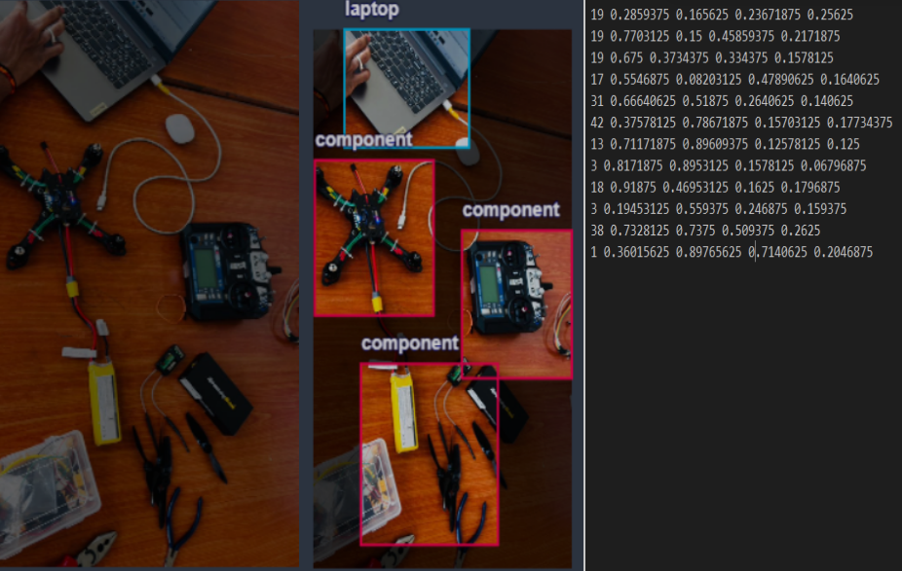
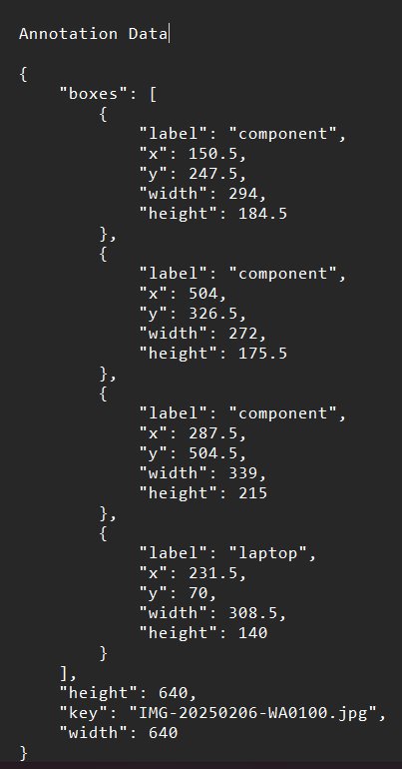

Slide 10
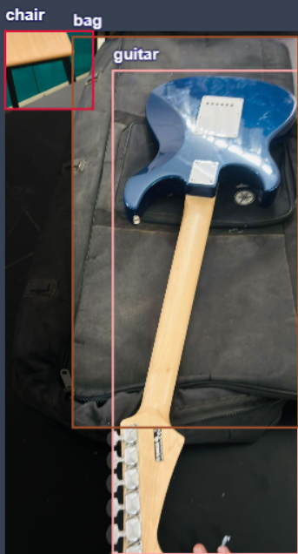
Applications and Future
1
Autonomous Vehicles
YOLOv8 powers object detection systems for self-driving cars, enabling safe navigation.
2
Security Systems
Real-time object detection systems for security cameras, identifying potential threats and anomalies.
3
Medical Imaging
Assisting medical professionals in diagnosing and treating diseases by identifying objects in medical images.

Slide 11
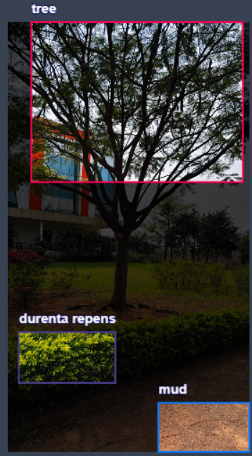
Conclusion and Future Directions
YOLOv8 offers a powerful and versatile tool for object detection, empowering developers to build innovative solutions across various domains.

